Slide 1
GAJTANLESS
“A system that sets the astronauts free from tangling ropes”
Gjoshev Kristijan
(Ѓошев Кристијан)
Dungevski Dimitar
(Дунгевски Димитар)

Slide 2
THE PROBLEM

Slide 3
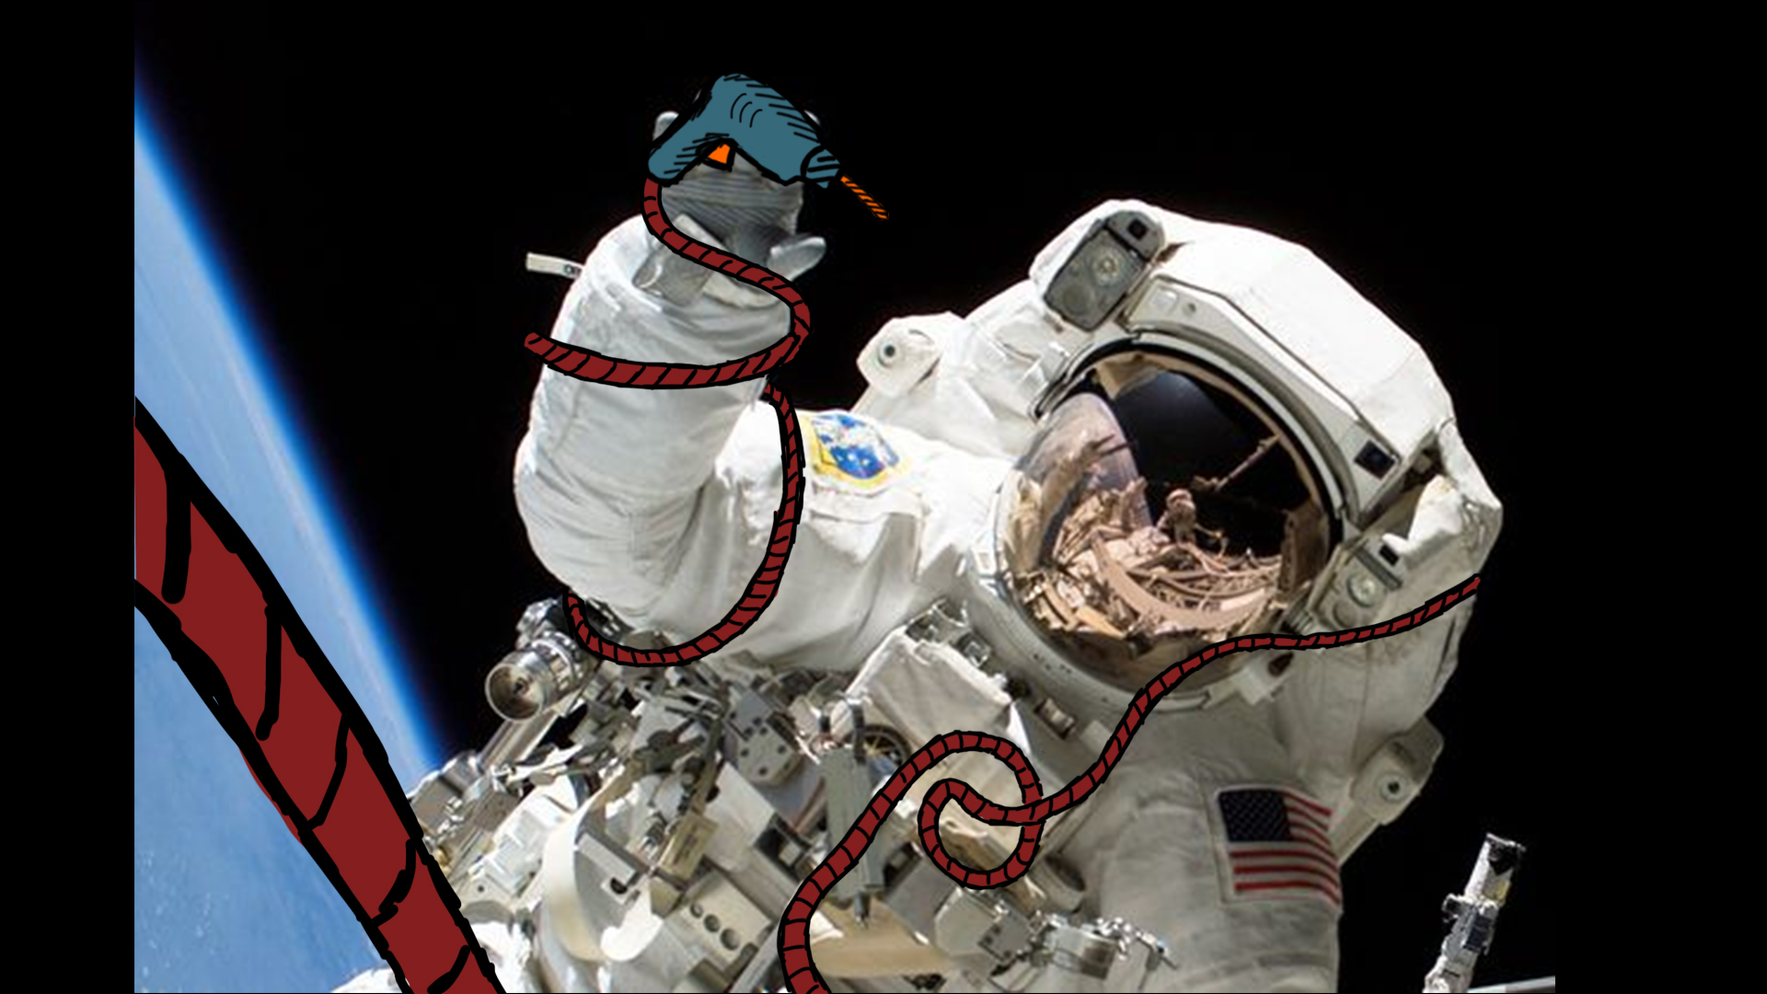
TANGLING ROPES PROBLEM

Slide 4
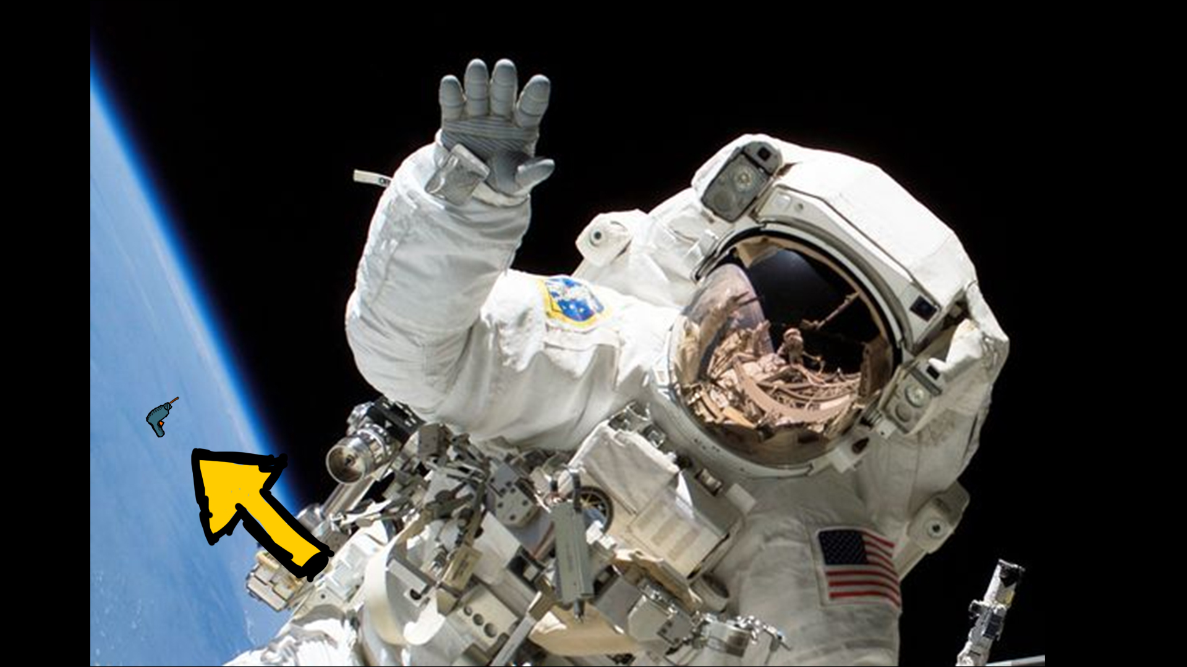
THE OBJECTS CAN FLOAT AWAY

Slide 5
THE SOLUTION

Slide 6
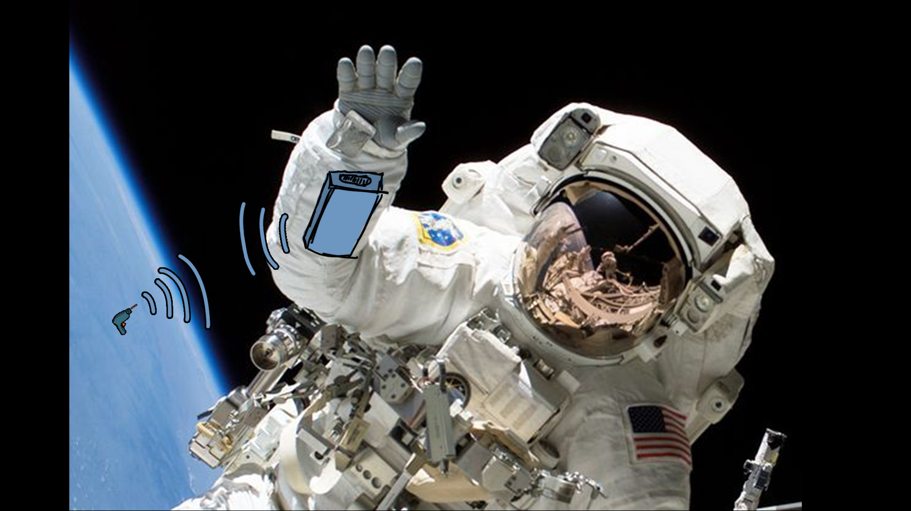
A DEVICE CONTROLLS THE LOCATION OF THE OBJECTS

Slide 7

THE ASTRONAUT IS WARNED AND SENDS A PROBE

Slide 8
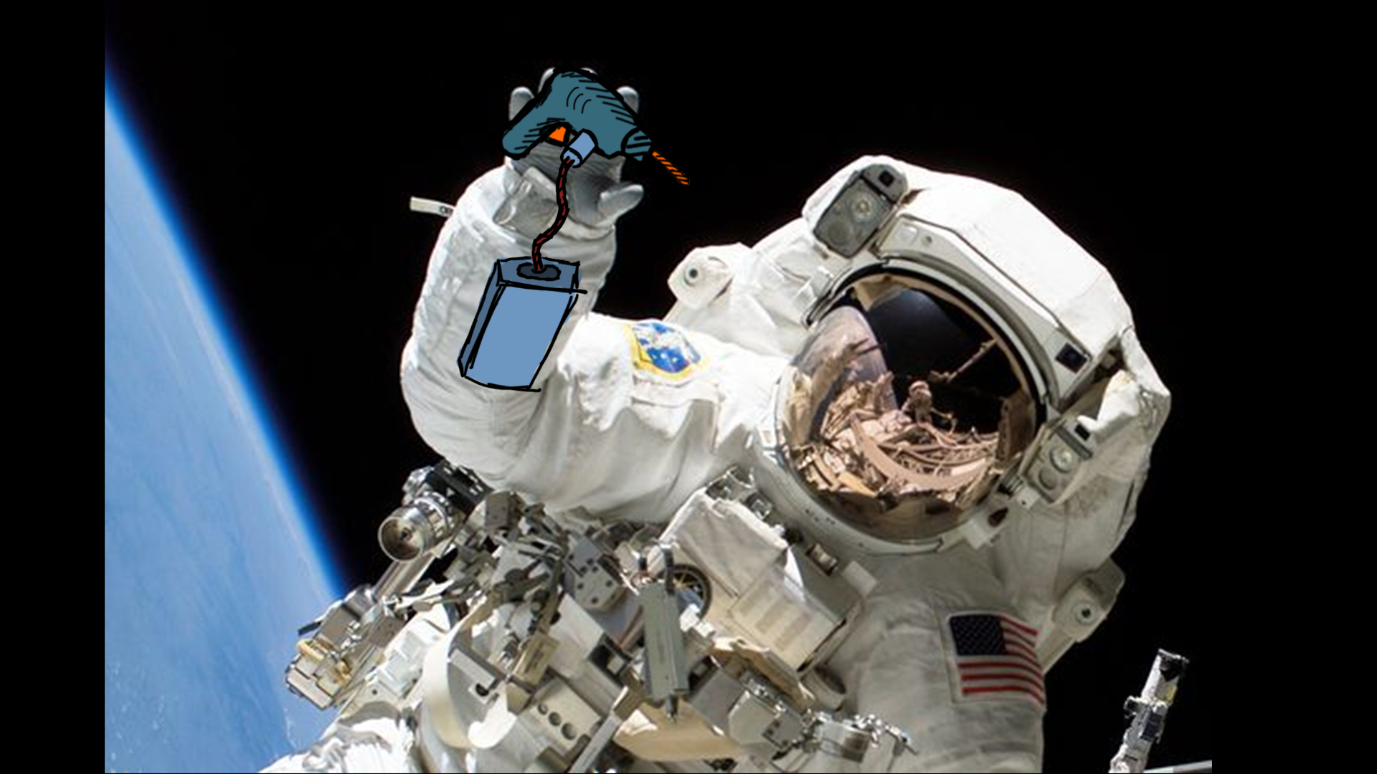
EVERYTHING IS UNDER CONTROL AGAIN

Slide 9
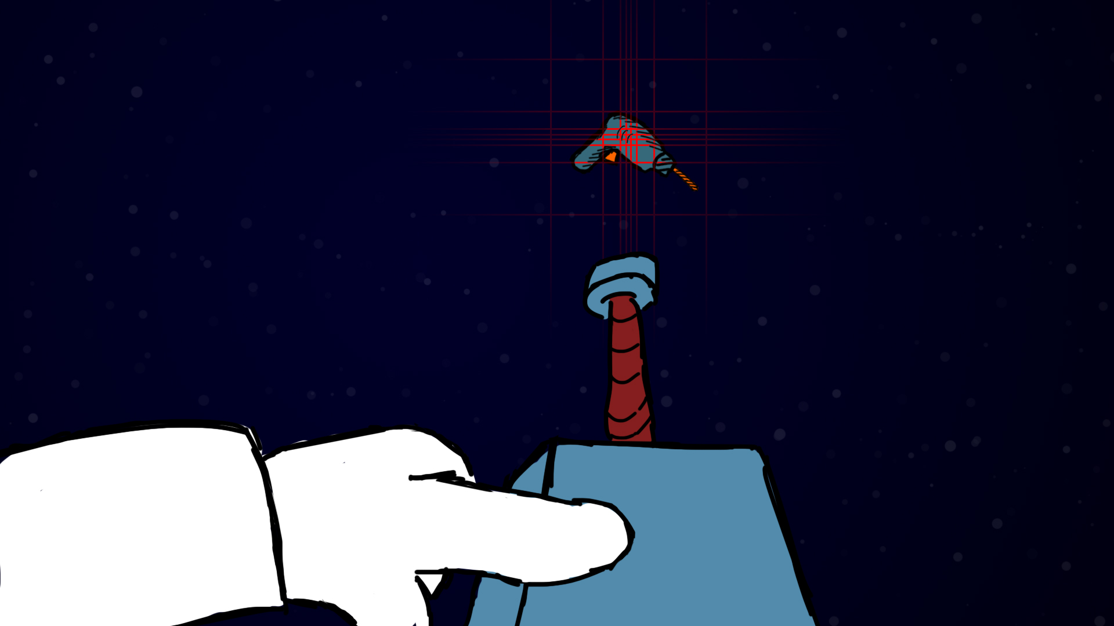
POINT AND SHOOT

Slide 10
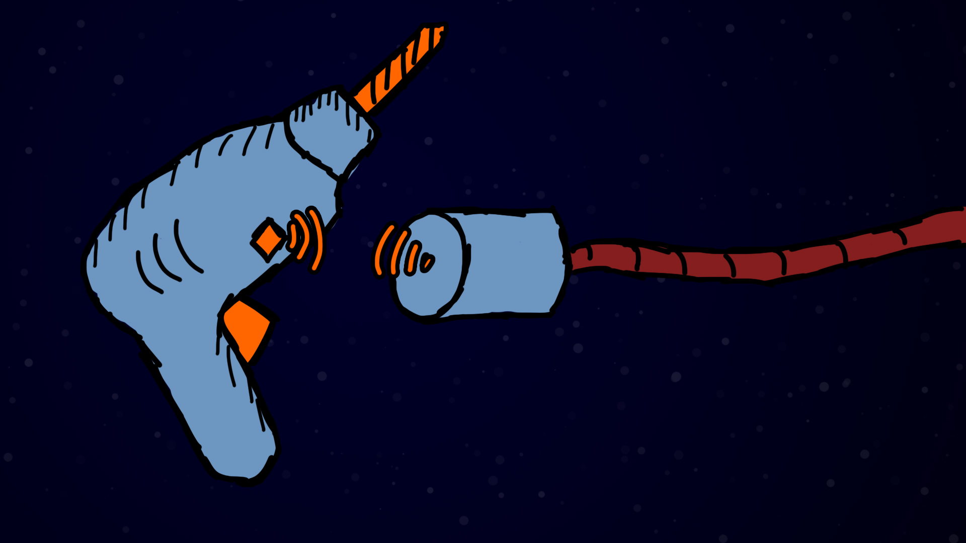
THE PROBE DOES EVERYTHING AUTOMATICALLY

Slide 11
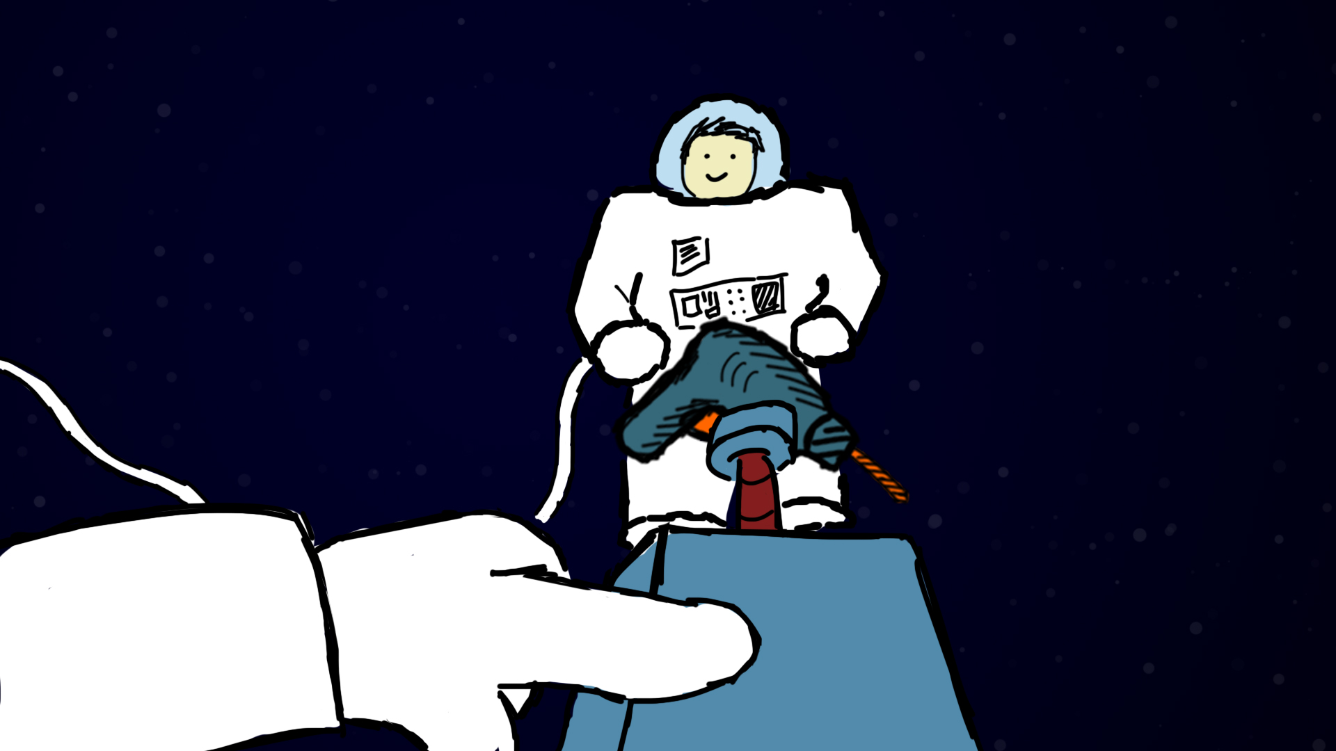
SEND OBJECTS TO OTHER ASTRONAUTS AT DISTANCE

Slide 12
QUESTIONS?

Slide 13
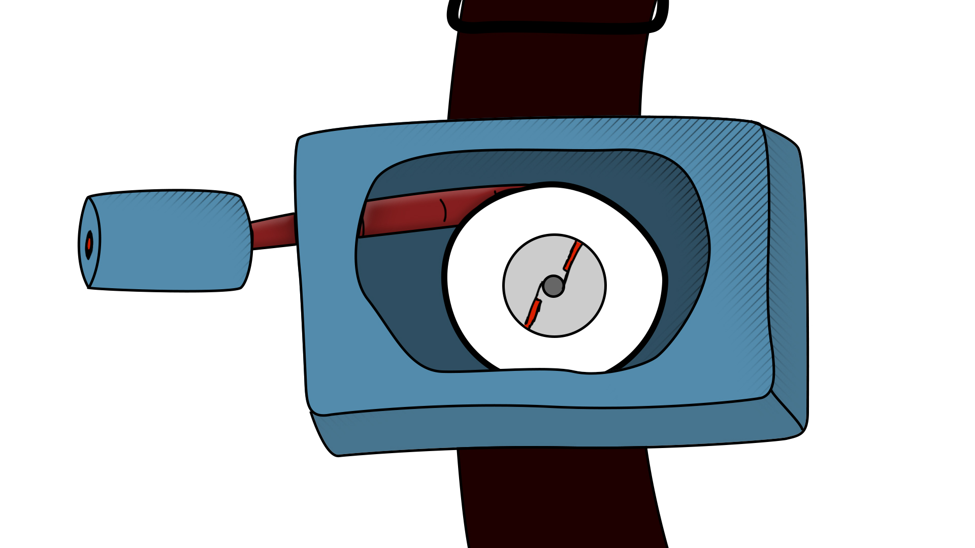

Slide 14


